Slide 1
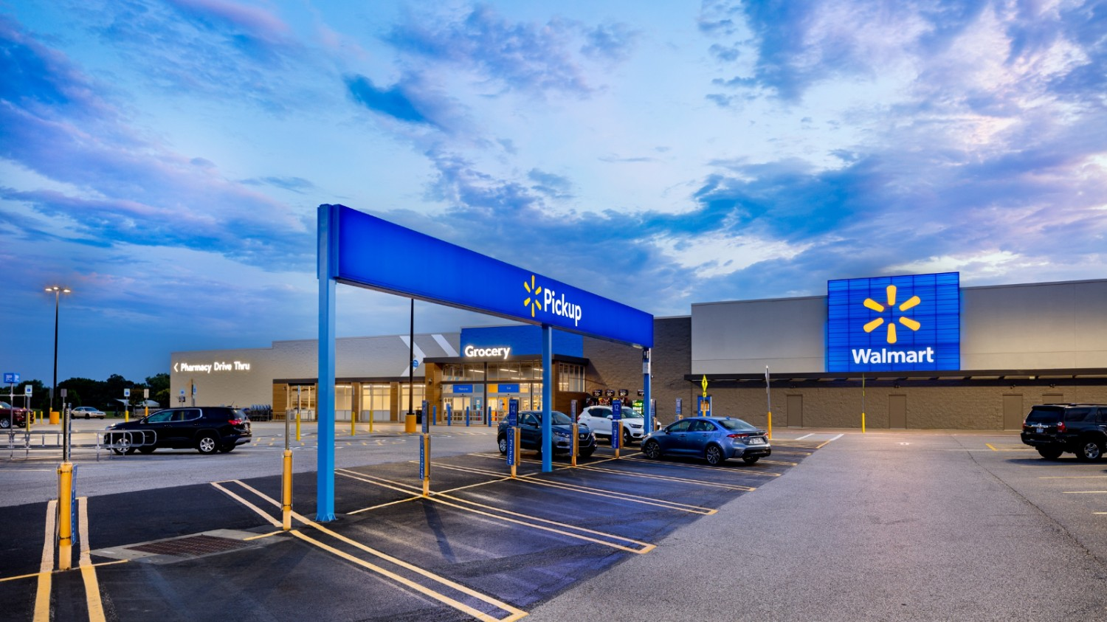

Supply chain
Case Study and Report
Walmart
Group 2 1.Anurag Saha 2.Aparna Pandey
3. Aritra Ray 4.Arpit Bhardwaj
5.Bandari Shikhara

Slide 2
Walmart
Key Elements in the Presentation
Company Overview
How the firm has addressed those supply chain challenges?
Addressed those supply chain challenges
Answer to all the respective questions, asked
Explain the product/service they offer
Major supply chain components.
Major supply chain performance drivers
Current supply chain related challenges faced by the firm

Slide 3
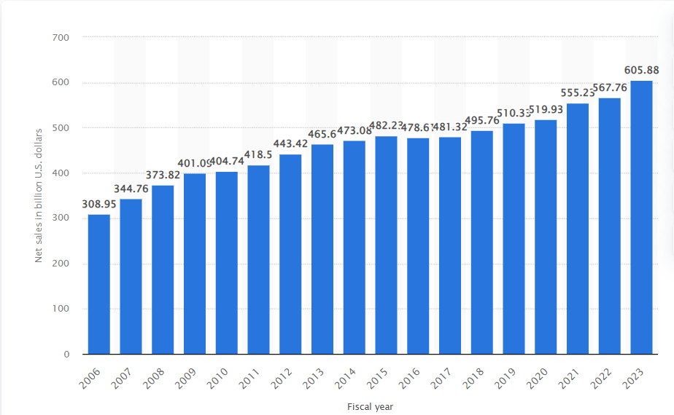
Company Overview
Walmart Inc. is an American multinational retail corporation that operates a chain of hypermarkets, discount department stores, and grocery stores, headquartered in Bentonville.
Founded by brothers Sam and James "Bud" Walton , in Arkansas in 1962. Current CEO is Carl Douglas McMillon since 2014.
As of 2023 its revenues rise 6.7% year over year, an increase of $38.5 billion.
As of Sept 21, 2023, generated profit & market value are $611,289M and $11,680M respectively with a strength of 2100,000 employees (appx.).

Slide 4
Walmart
Products /Service Walmart offers :
Walmart sells a diverse range of products, such as electronics, books, groceries, and jewelry, as well as offering photo lab services, including one-hour development for digital and film photographs.
Walmart has a pricing strategy offering over 300 generic medications for $4, saving customers up to $3 billion. Walmart provides prescription drugs through in-store pick-up or mail order services for long-term medications.
Walmart provides affordable medications, financial services, and check cashing options to its customers. It also offers a store credit card without an annual fee, bill payments, money transfers, and gift cards.
Walmart and T-Mobile have teamed up to offer the Walmart Family Talk Wireless service, providing a family plan with unlimited text and voice calls starting at $45 with no yearly contract.

Slide 5
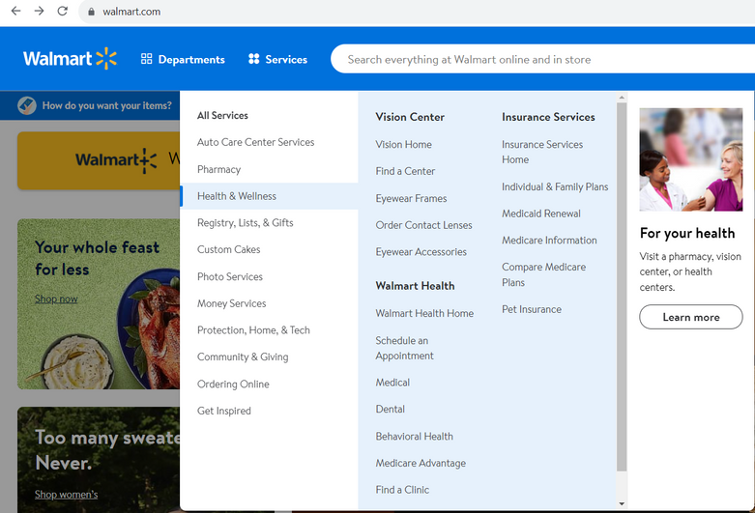
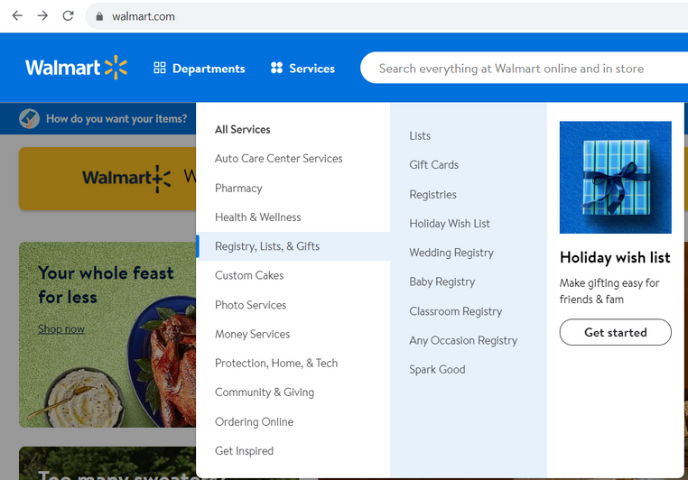
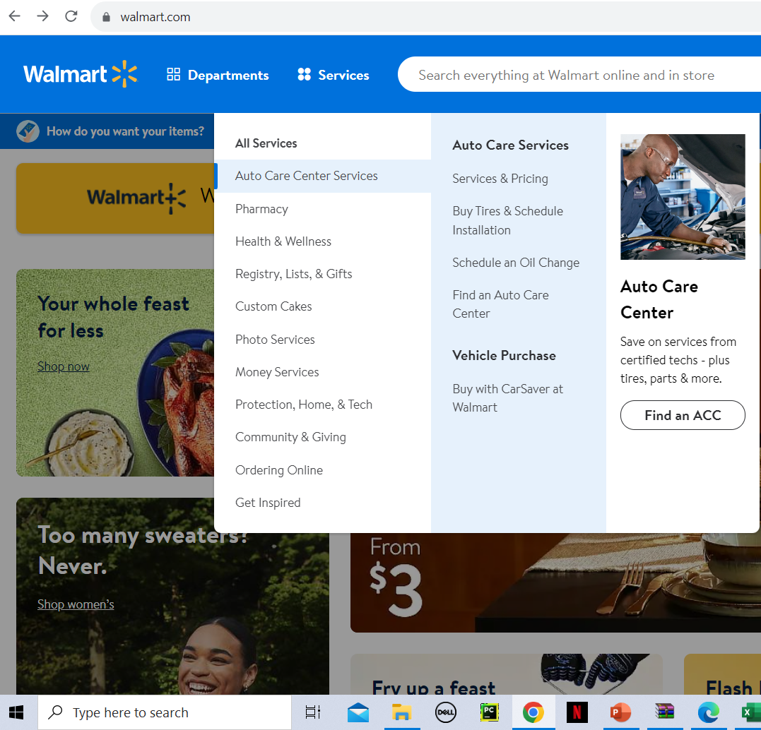
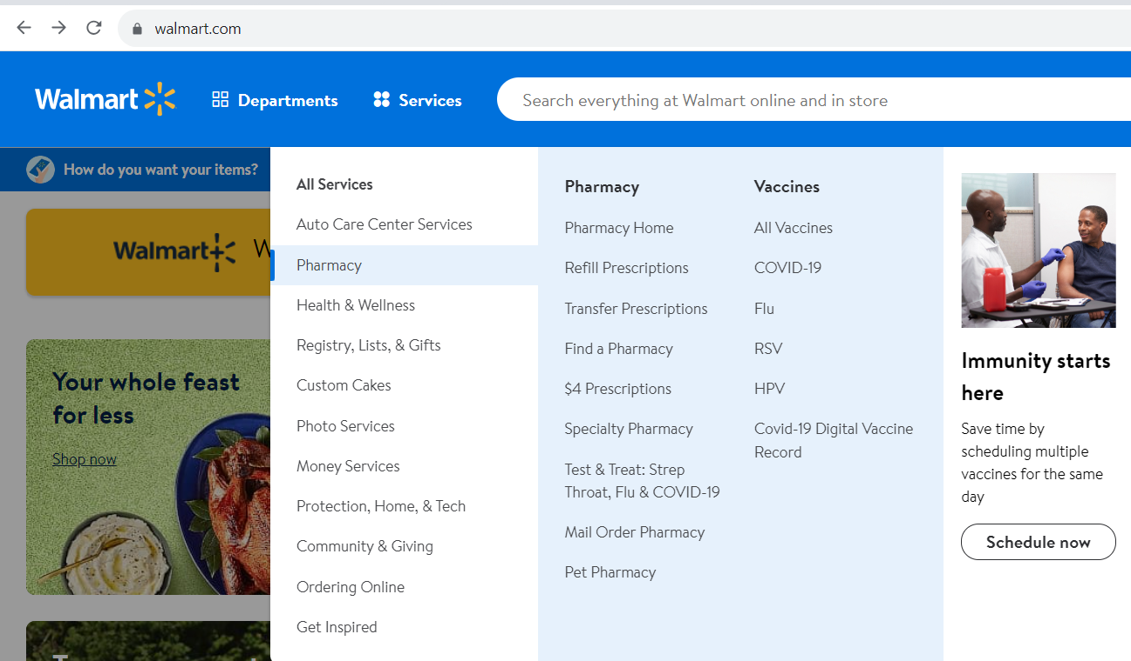
Walmart
Products /Service Walmart offers :

Slide 6
Major Components of Supply Chain for Walmart
Supplier Management and Procurement | Distribution and Logistics | Inventory Management | Information Systems, Quality Control, and Customer Service
Walmart maintains a diverse network of carefully chosen suppliers, employing efficient procurement practices like bulk purchasing and just-in-time inventory management to minimize costs and ensure a steady supply of products. | Walmart's extensive distribution network, which includes cross-docking, allows for efficient movement of products from suppliers to stores, reducing warehousing needs. | Walmart pioneers advanced inventory management techniques using technology and data analytics to maintain low inventory levels while ensuring product availability, reducing holding costs, and increasing turnover. | Walmart heavily invests in information systems and technology, including the renowned Retail Link system for real-time data sharing with suppliers. The company places a strong emphasis on product quality and safety, along with providing high-quality customer service.

Slide 7
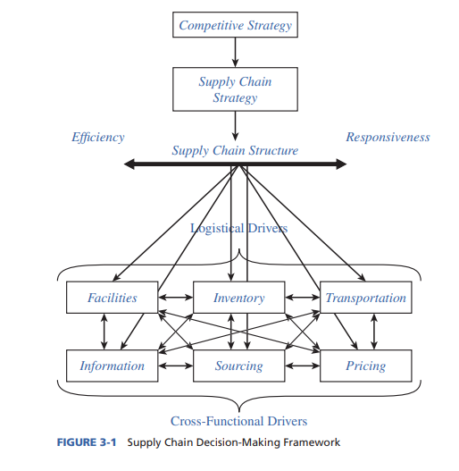
SUPPLY-CHAIN FRAMEWORK FOR STRUCTURING DRIVERS

Slide 8
Major supply chain performance drivers
Cost Efficiency | Inventory Turnover | Information Systems and Data Sharing | Transportation | Sourcing and Procurement
Cost efficiency is at the forefront of Walmart's supply chain strategy. The company's emphasis on cost reduction through procurement, efficient distribution, and inventory management enables it to offer competitive prices to customers. | Walmart's supply chain prowess lies in its ability to maintain low inventory levels while ensuring product availability, resulting in high inventory turnover. This approach reduces holding costs and optimizes capital efficiency | Walmart heavily invests in information systems and technology, notably the Retail Link system, which enables real-time data sharing with suppliers. This enhances demand planning and allows suppliers to adjust production and shipping schedules accurately. | Walmart's vast distribution network and efficient transportation assets facilitate the movement of products from suppliers to stores, while the company emphasizes transportation efficiency and sustainability. | Efficient procurement practices, including bulk purchasing and continuous collaboration with suppliers, help Walmart minimize costs and ensure a steady supply of products.

Slide 9
Walmart
Walmart, 10,000+ stores, 24 countries, 2.2M employees, grapples with efficient goods movement and timely delivery.
Sourcing Goods from various suppliers and vendors Sustainability
Managing Inventory Levels Effectively
The rapidly Changing nature of the Retail industry
Increasing competition from e-commerce retailers.
The need to improve sustainability and reduce the environmental impact of its supply chain.
Ensuring ethical labor practices and responsible sourcing in a global supply chain.
Managing omnichannel retail and balancing inventory in physical stores and e-commerce warehouses.
Challenges faced

Slide 10
How Walmart has addressed those supply chain challenges?
Solution # 1 | Investment in technologies such as artificial intelligence and machine learning
Solution # 2 | Strategic Partnerships and Collaborations
Solution # 3 | Imrpovisation of Sustainability
 | A Walmart Plus Subscription Model
Solution #4

Slide 11
Walmart
1. Supply Chain Automation and Robotics: Utilize automation and robotics for efficient order processing and cost savings in distribution and stores.
2. Dynamic Routing and Transportation Optimization: Apply AI and real-time data for optimal transportation routes, reducing costs and ensuring punctual deliveries.
3. Smart Inventory Management: Deploy IoT and smart shelves for real-time inventory monitoring, minimizing waste through efficient restocking.
4. Customised Shopping Experiences: Use data analytics for personalized shopping experiences with tailored recommendations, fostering customer loyalty.
5. Global Supply Chain Visibility: Establish end-to-end supply chain visibility for ethical labor practices and responsible sourcing.
6.Data Security and Privacy: Maintain customer trust in e-commerce by securing data and financial transactions.
How we
would have
addressed it!?

Slide 12
Metrics | 2010 | 2009
ROE | 272.7 | 501.5
ROA | 8.67% | 9.44%
Profit Margin | 3.853 | 3.669
Asset Turns | 2.4 | 2.5
APT | 6.0268 | 6.3826
ART | 98.5 | 103.55
C2C | -0.0467 | -0.0337
INVT | 9.187 | 8.8104
PPET | 3.99 | 4.227
Case Study Questions and Answers
Evaluate Wal-Mart’s financial performance based on
the various metrics discussed in Section 3.1, such as ROE,
ROA, profit margin, asset turns, APT, C2C, ART, INVT,
and PPET.
ROE = Net Income/Average Shareholder Equity
ROA = Earnings before interest/Average total assets
= Net income + [Interest expense * (1 - Tax rate)]/Average total assets
APT = Cost of goods sold/Accounts payable
Profit margin=Earnings before interest/Sales revenue
Asset turnover=Sales revenue /Total assets
ART = Sales revenue/Accounts receivable
INVT = Cost of goods sold/Inventories
PPET = Sales revenue/PP&E

Slide 13
Compare the metrics for Wal-Mart with similar metrics for Amazon from Table 3-1.
Which metrics does Amazon perform better on? Which metrics does Wal-Mart perform better on?
ROE and ROA:
In 2009, Walmart had a significantly higher ROE compared to Amazon, indicating that Walmart's leverage on equity was much greater.
Walmart also had a higher ROA in both years, suggesting that they generated more income for each dollar of assets.
Profit Margin:
Amazon had a higher profit margin in 2009, but in 2010, Walmart's profit margin improved and surpassed Amazon's.
Inventory Turnover (INVT):
Both Walmart and Amazon had similar inventory turnover metrics, indicating efficient inventory management.
Property, Plant, and Equipment Turnover (PPET):
Walmart had a higher PPET in 2009, showing that their assets were utilized more effectively for generating revenue.
Cash-to-Cash (C2C) Cycle:
Amazon had a shorter C2C cycle in 2009, meaning they collected money from sales more quickly compared to Walmart.
Accounts Receivable Turnover (ART):
Walmart's ART was higher, indicating that they collected money from sales more rapidly compared to Amazon.

Slide 14
What supply chain drivers and metrics might explain this difference in performance?
Supply Chain Drivers:
Supply Chain Metrics:
Inventory Strategy:
Inventory Turnover (INVT):
Walmart's inventory strategy is "low-cost, low-inventory" to minimize holding costs, while Amazon follows a "lean inventory" strategy by minimizing in-house inventory to reduce holding costs and stocking products in regional distribution centers.
Walmart's higher inventory turnover is due to its large physical store presence, while Amazon's lean inventory strategy results in lower turnover. Walmart's PPET is lower due to its extensive physical store infrastructure, while Amazon's is higher due to its focus on fulfillment centers and technology.
Distribution Network:
Walmart's supply chain is geared towards in-store inventory management and restocking, whereas Amazon's supply chain focuses on e-commerce order fulfillment through strategically located fulfillment centers for quick and efficient shipping.
Cash-to-Cash (C2C) Cycle:
The C2C cycle for Walmart may be longer due to its reliance on physical store sales and inventory, while Amazon's tends to be shorter due to faster cash conversion in e-commerce. Additionally, Accounts Receivable Turnover (ART) may be a relevant metric.
Procurement and Supplier Relations:
Walmart maintains low prices through cost negotiations with suppliers, while Amazon prioritizes product selection, diversity, and time-to-market on their e-commerce platform by collaborating with a wide range of suppliers.

Slide 15
In 2010, Walmart announced that it planned to
move into urban areas in the United States by building and
operating smaller format stores compared to the large
stores it had operated up to that point.

Slide 16
Which supply chain
metrics will be impacted by this move?
Inventory turnover - With smaller stores, inventory levels would need to be lower and turnover faster to avoid out-of-stocks. This requires more frequent deliveries and coordination with suppliers.
Distribution centre capacity - They would need more distribution centres located closer to urban areas to enable quick replenishment of the smaller stores. This could decrease overall distribution centre capacity utilisation.
Supplier lead time - For fast replenishment of perishables and frequent stock keeping units (SKUs), They would need to partner with suppliers who can provide shorter lead times. This requires suppliers to hold inventory closer to the urban stores.
Order frequency - Urban stores would likely place orders for replenishment more frequently and in smaller quantities. This increases order volume and processing costs for them and their suppliers.

Slide 17
How will this
move impact the various financial metrics? Why?
Revenue per square foot - Urban stores would have lower total revenues due to smaller size, but revenue per square foot would likely be higher due to higher sales densities in urban areas.
Operating expenses - Urban real estate, distribution, and labor costs are higher which increases operating expenses as a percentage of sales.
Net profit margin - The combination of lower revenues and higher expenses would likely reduce overall net profit margins for the smaller format stores.
Return on assets - The huge asset base required for large suburban stores results in higher returns on assets for the smaller urban stores.
Transportation costs - Delivery costs to urban stores are typically higher due to traffic, tolls, lack of dedicated delivery docks, etc. Walmart would need to account for higher transportation costs to supply its urban locations.
Labor costs - Urban stores typically have higher labor costs due to higher wages. Walmart would need to account for this in their operating costs.

Slide 18
THANK YOU

